Slide 1
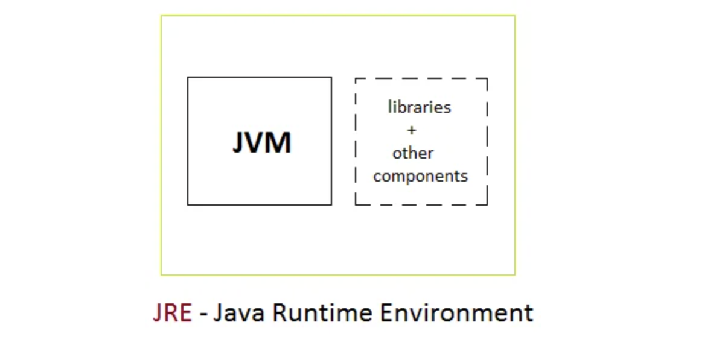
JRE(Java Runtime Environment)

Slide 2
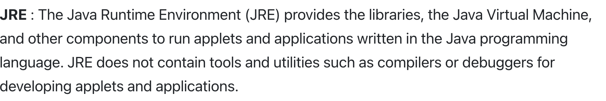
JRE(Java Runtime Environment)

Slide 3
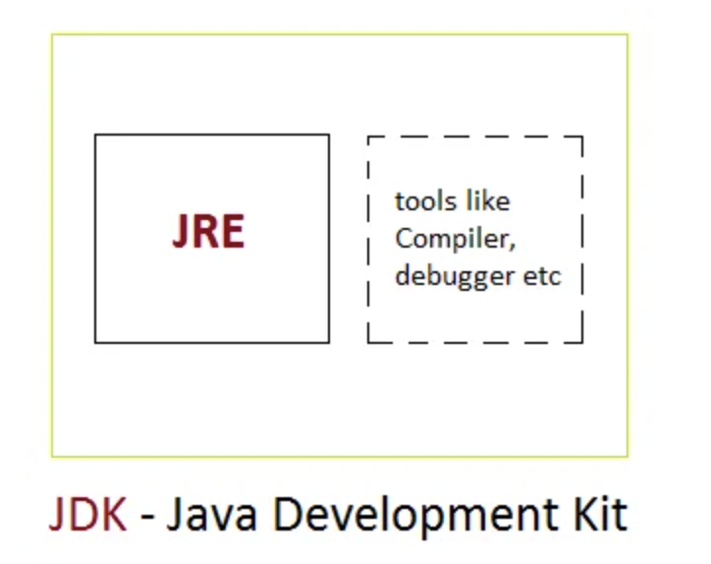
JDK(Java Development Kit)

Slide 4
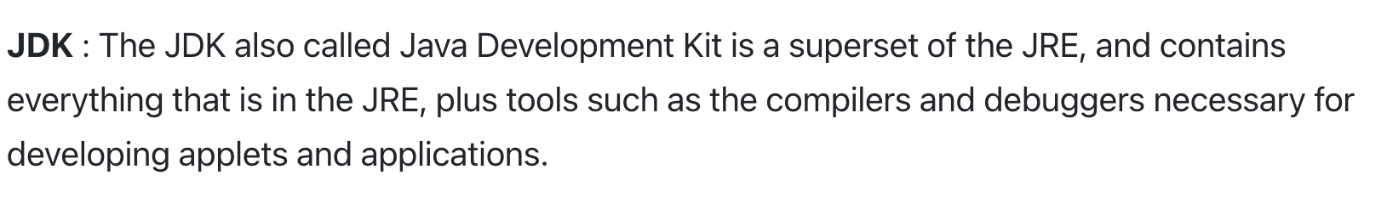
JDK(Java Development Kit)

Slide 5
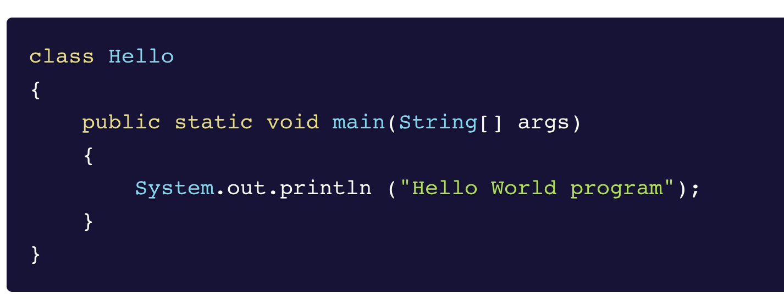
My First Java Program

Slide 6
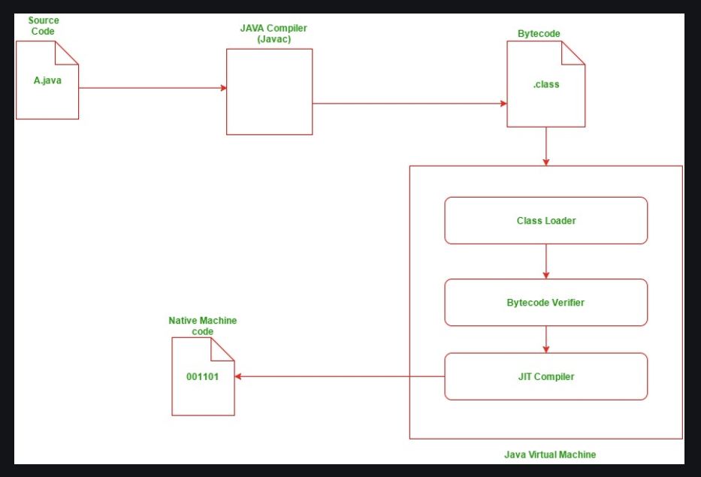
Compilation And Execution Of A Java Program

Slide 7
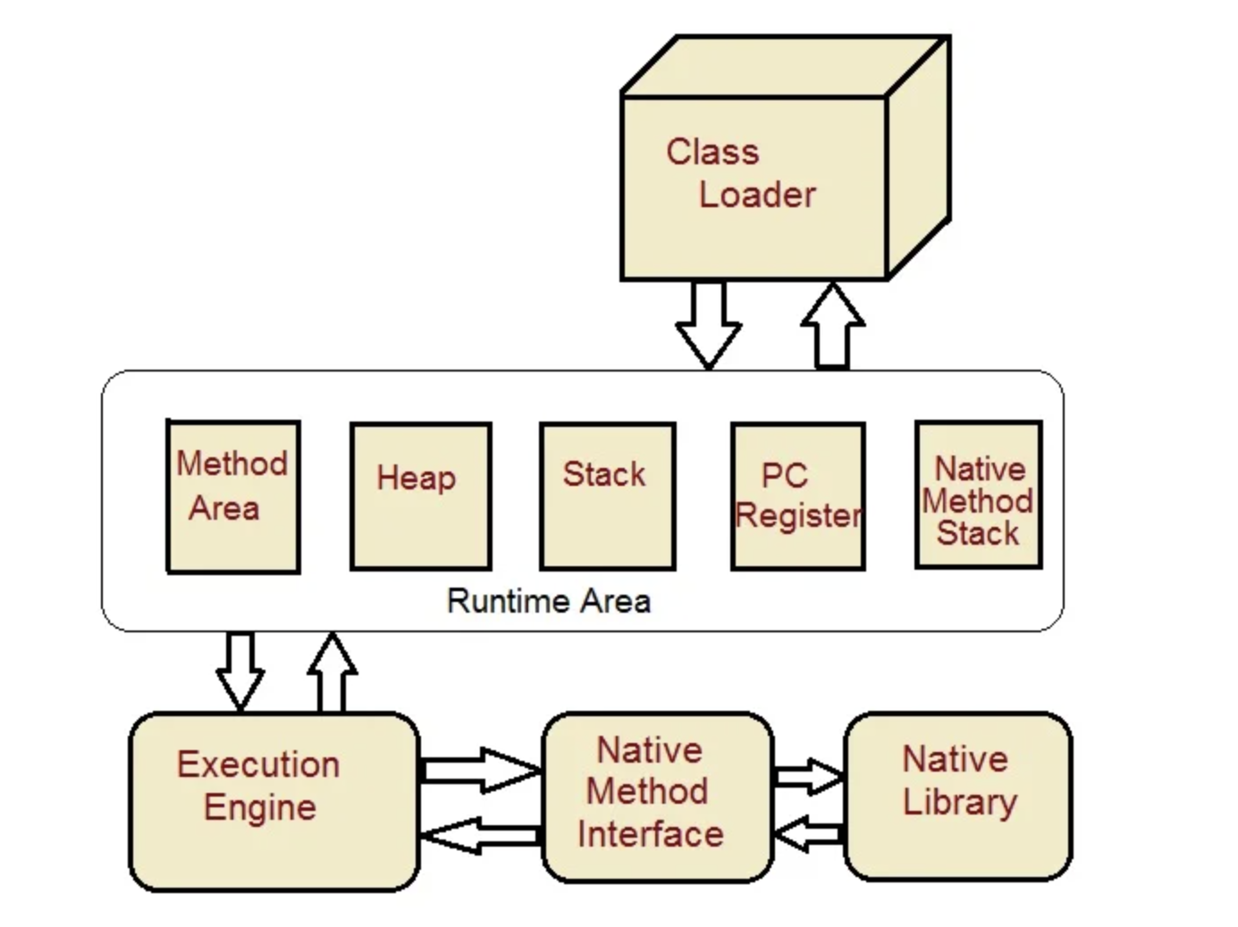
JVM Architecture

Slide 8
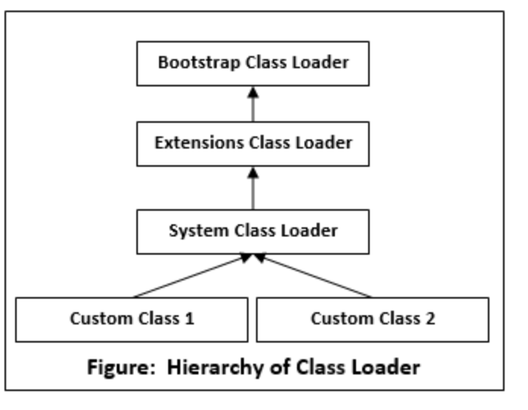
ClassLoader in Java

Slide 9
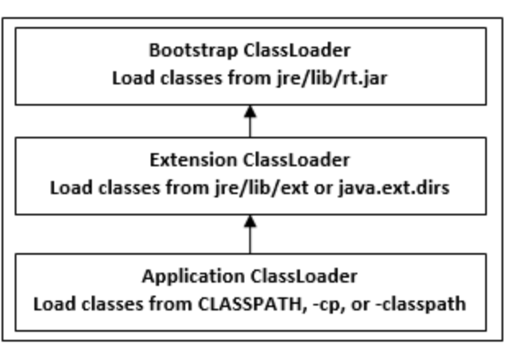
ClassLoader in Java

Slide 10
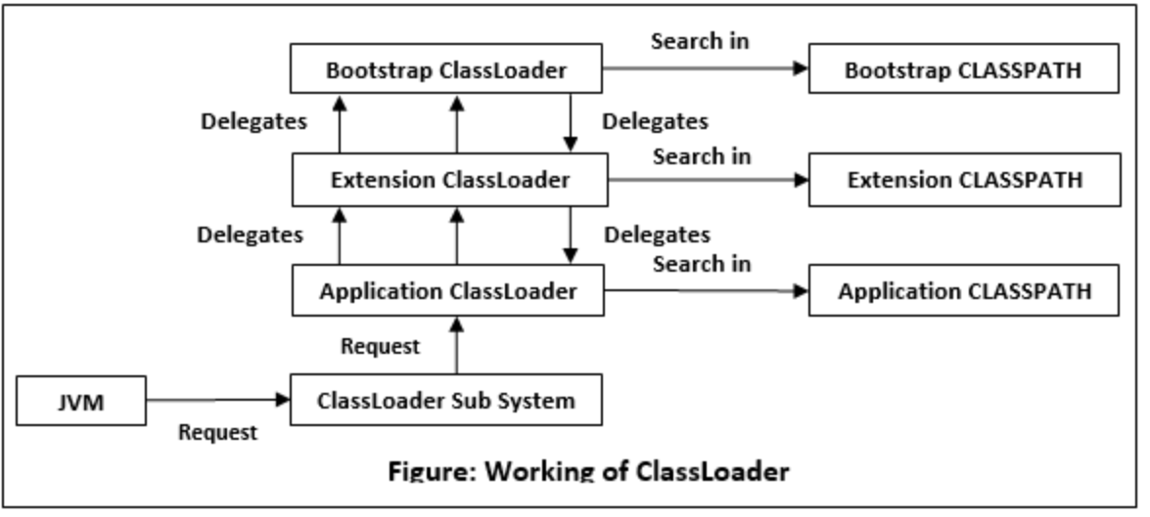
How ClassLoader Works in Java

Slide 11
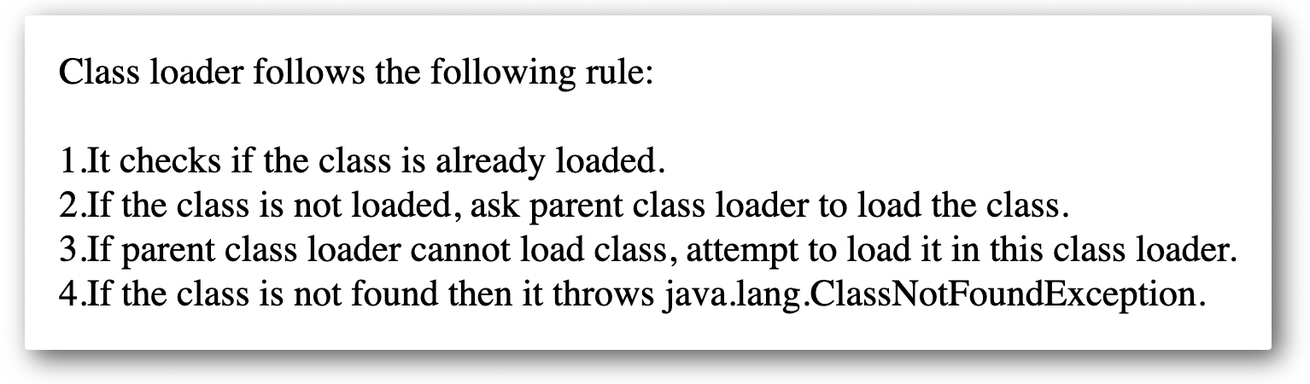
How ClassLoader Works in Java

Slide 12
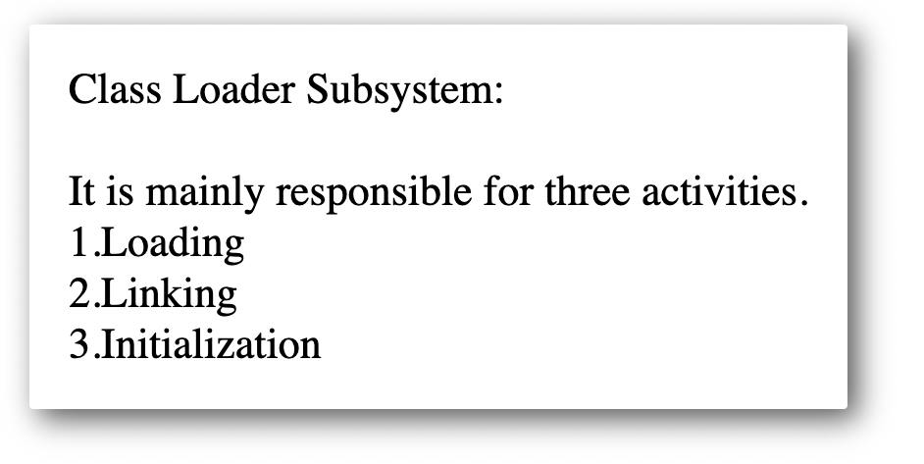
How ClassLoader Works in Java

Slide 13
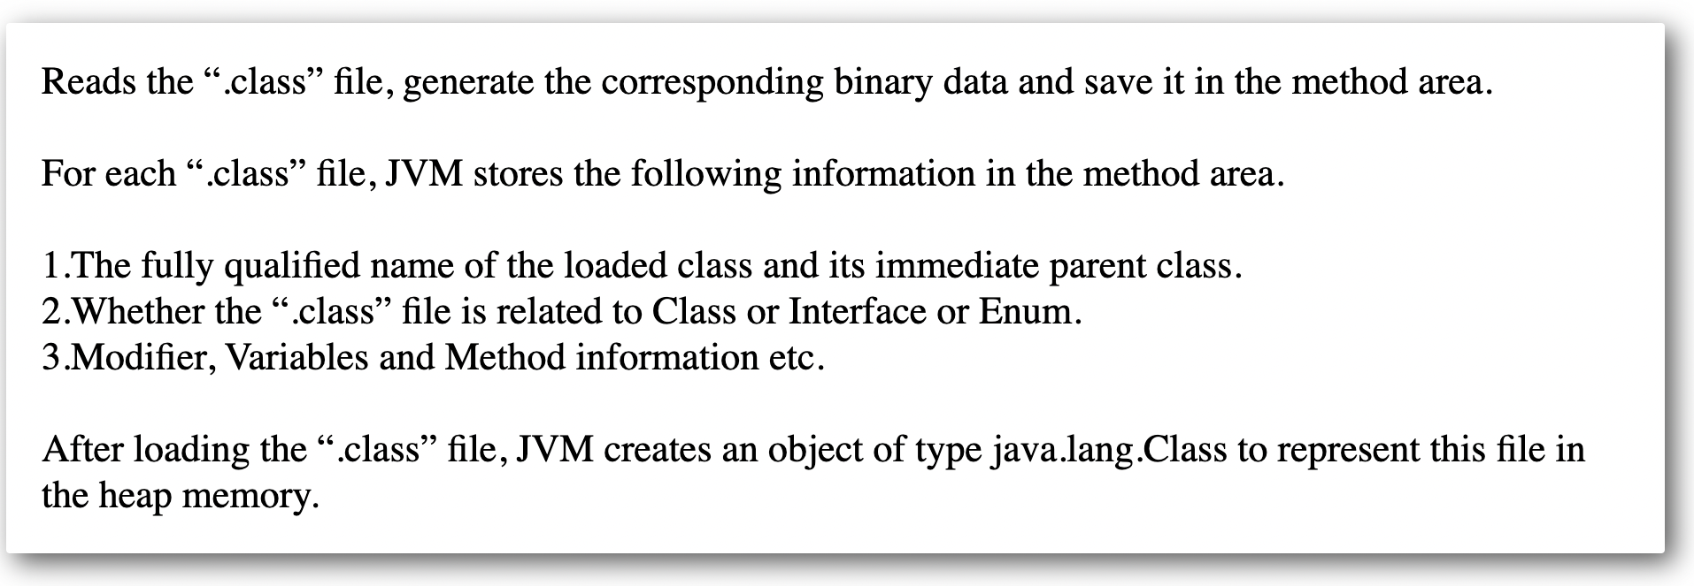
Loading By ClassLoader

Slide 14
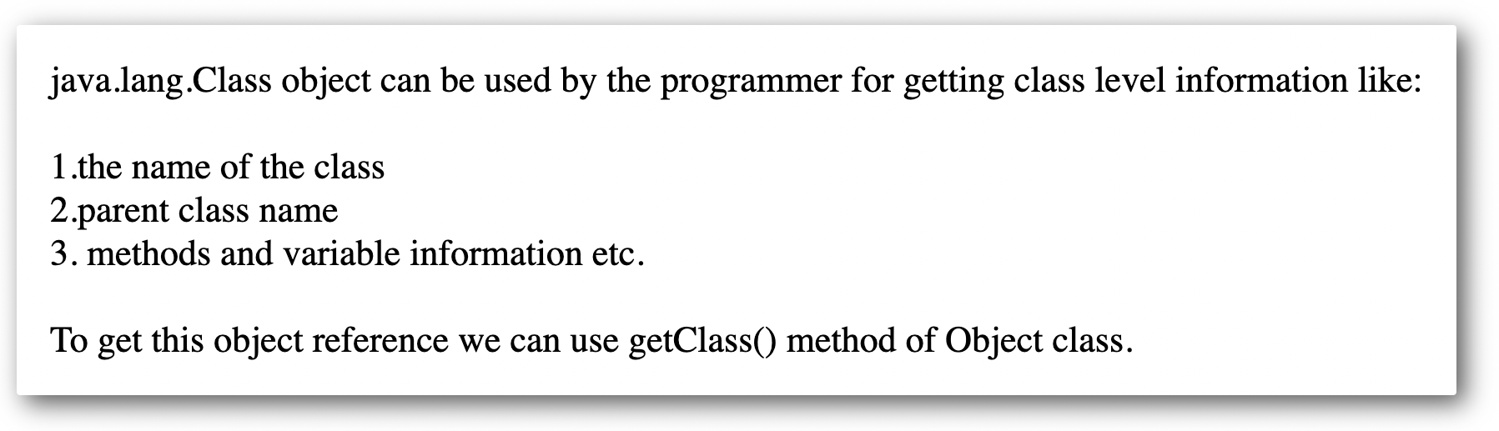
java.lang.Class class

Slide 15
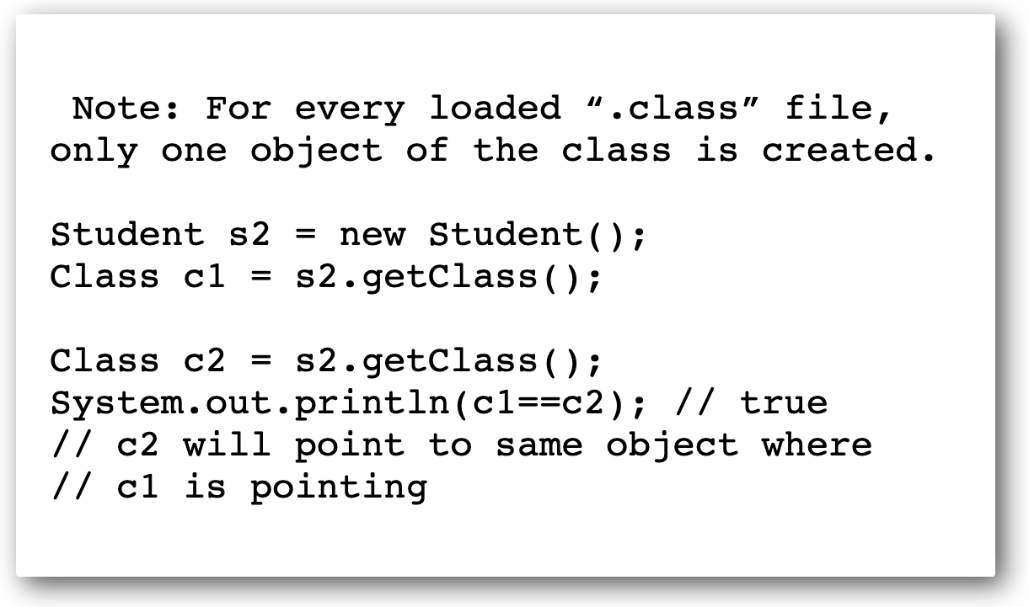
java.lang.Class class

Slide 16
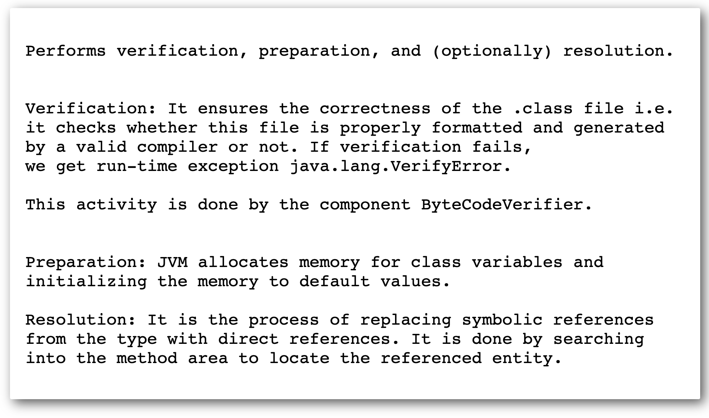
Linking By Classloader

Slide 17
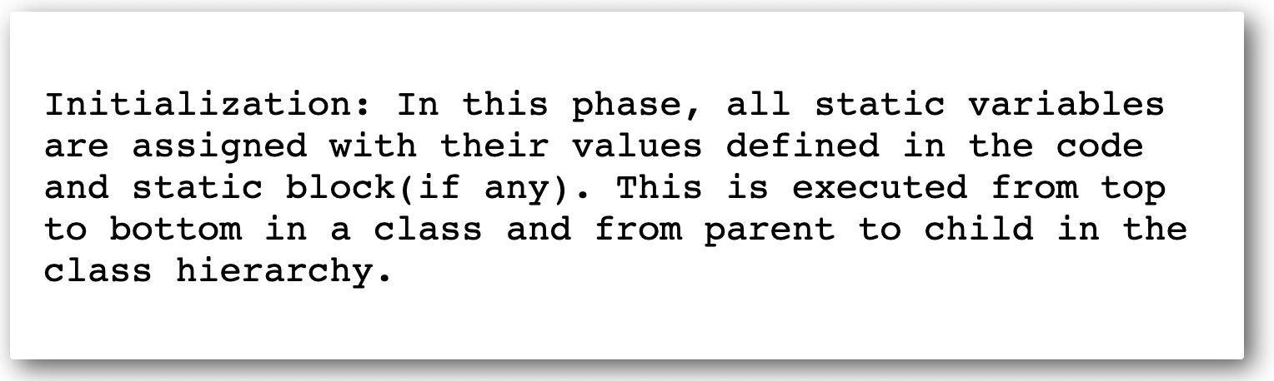
Initialization By Classloader

Slide 18
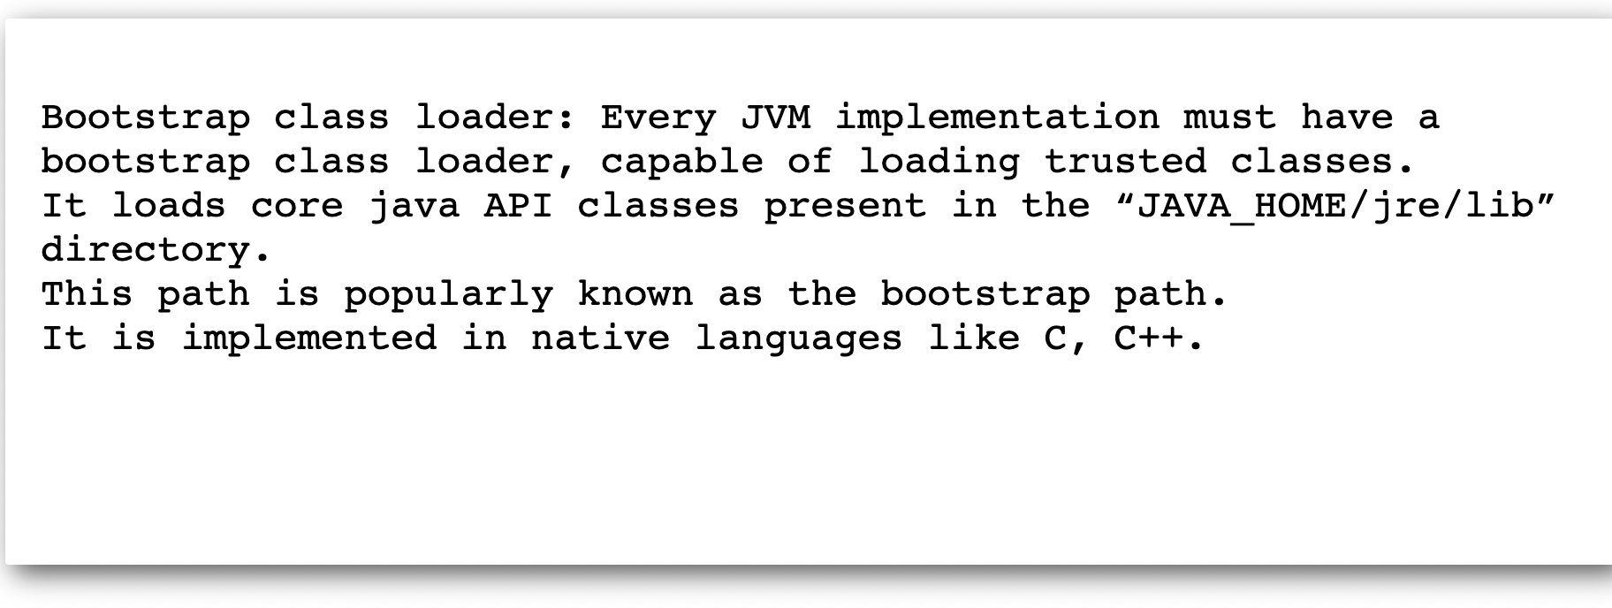
BootStrapClassloader

Slide 19
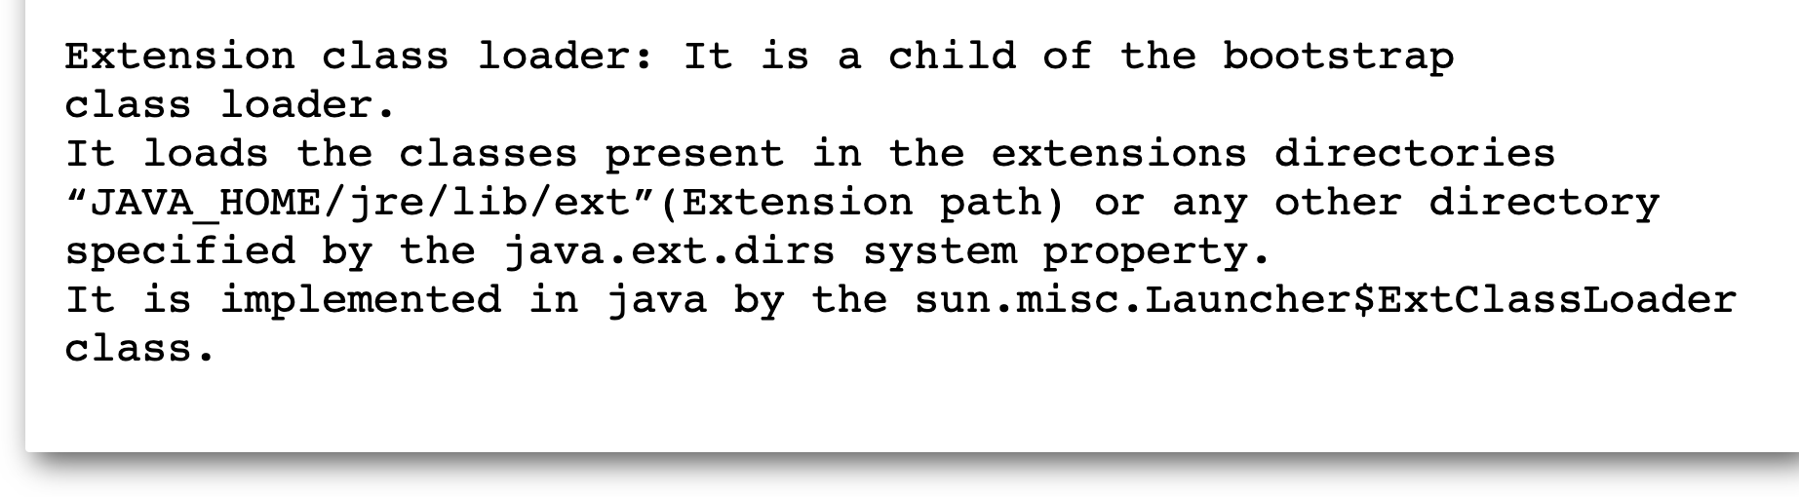
Extension Classloader

Slide 20
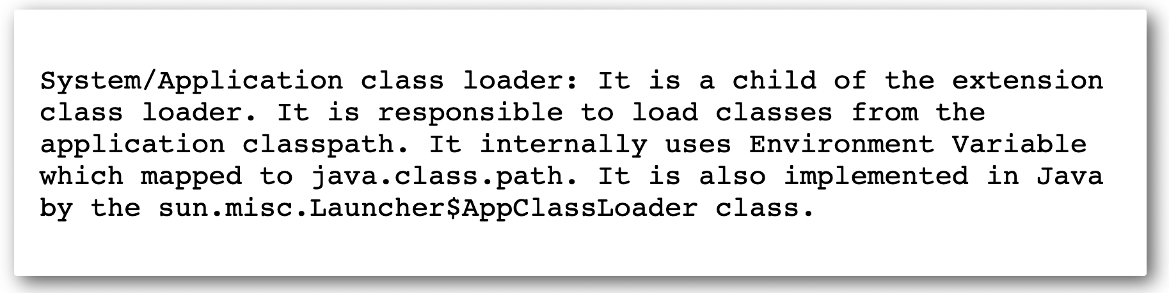
Application Classloader

Slide 21
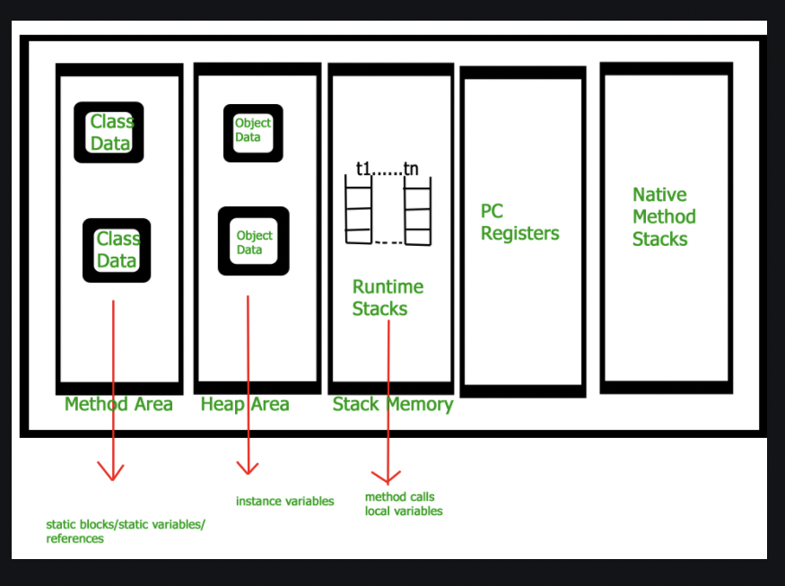
JVM Memory

Slide 22
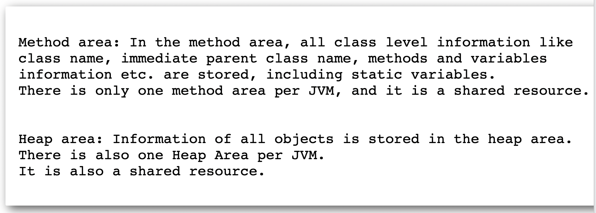
JVM Memory(Method Area and Heap Area)

Slide 23
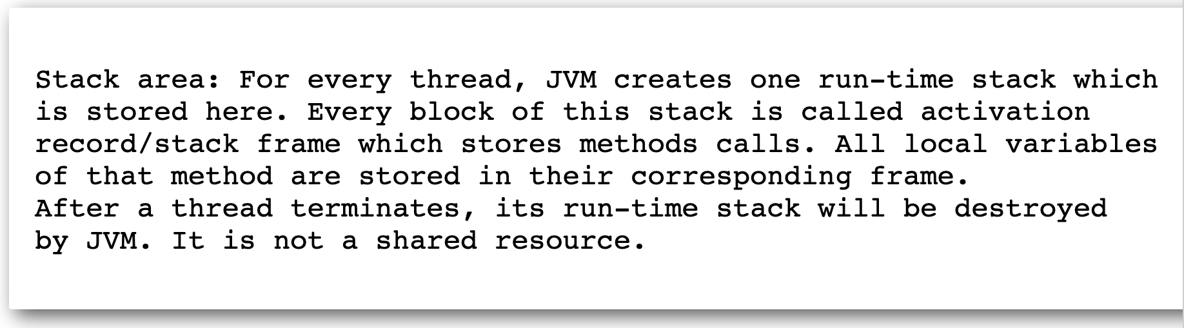
JVM Memory(Stack Area)

Slide 24
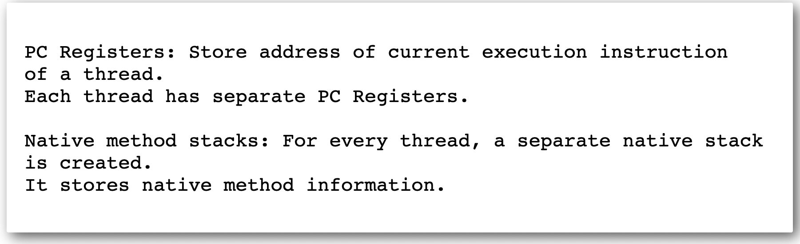
JVM Memory(PC Registers and Native Method Area)

Slide 25
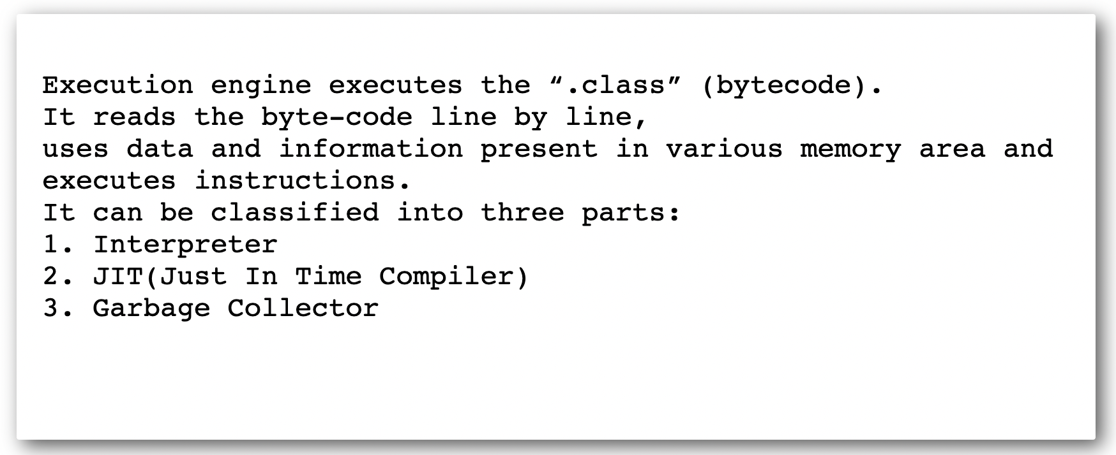
JVM : Execution Engine

Slide 26
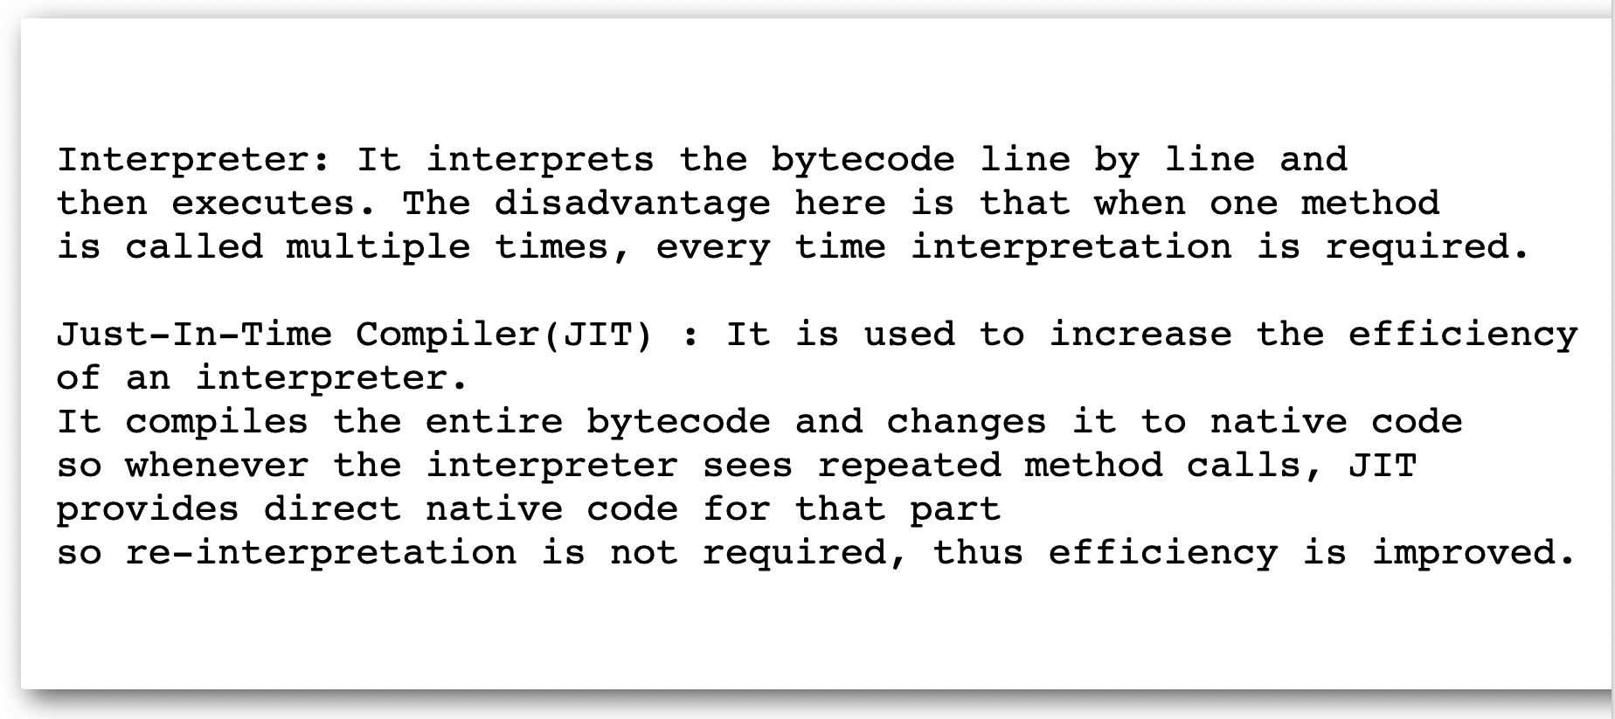
JVM : Execution Engine(Interpreter and JIT)

Slide 27
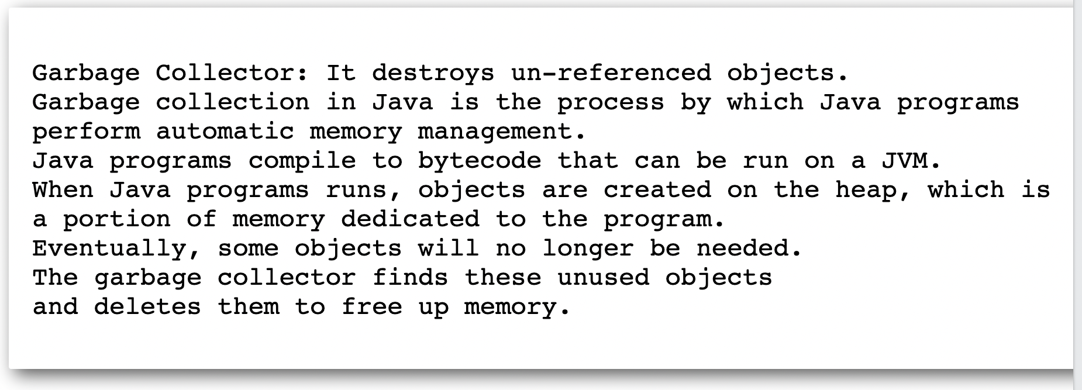
JVM : Execution Engine(Interpreter and JIT)

Slide 28
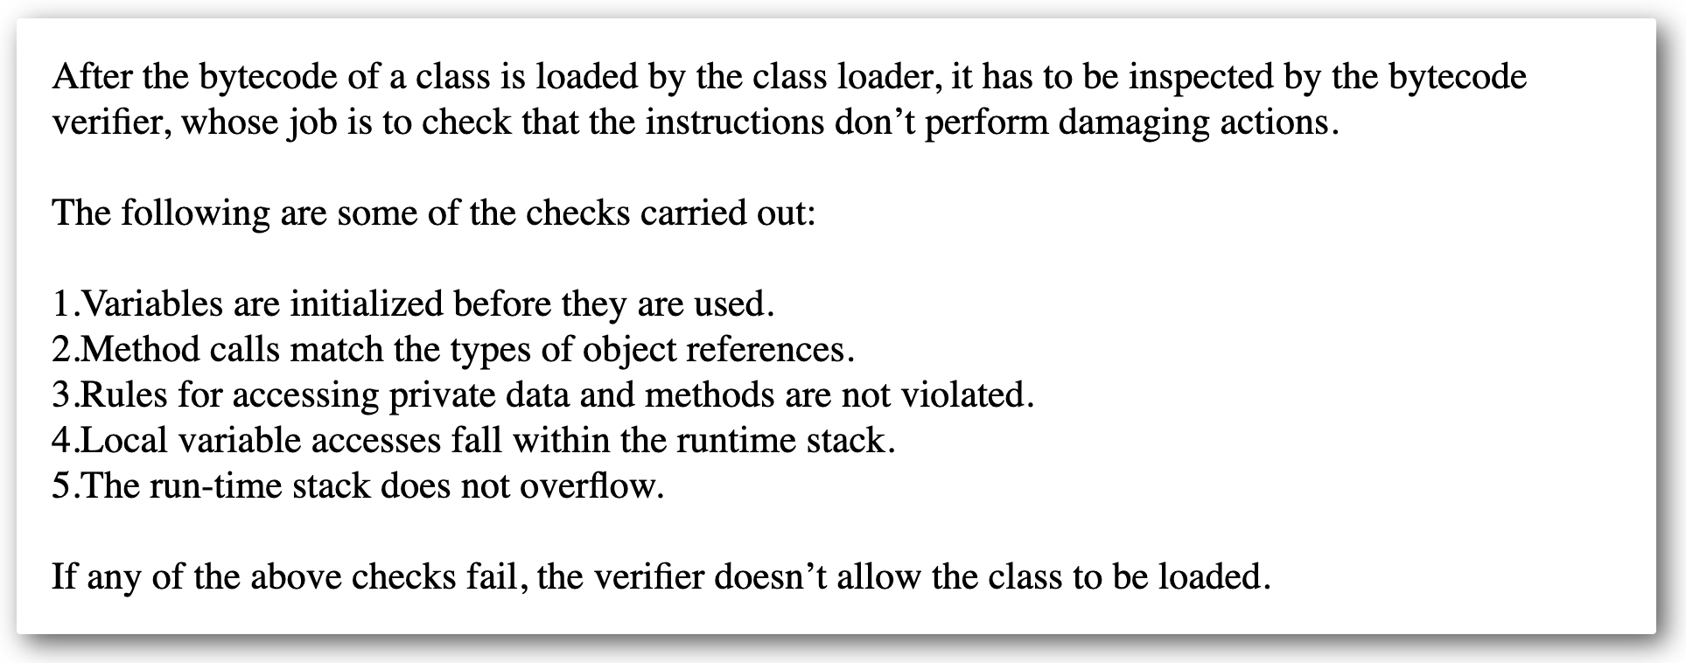
Java: Bytecode Verifier

Slide 29
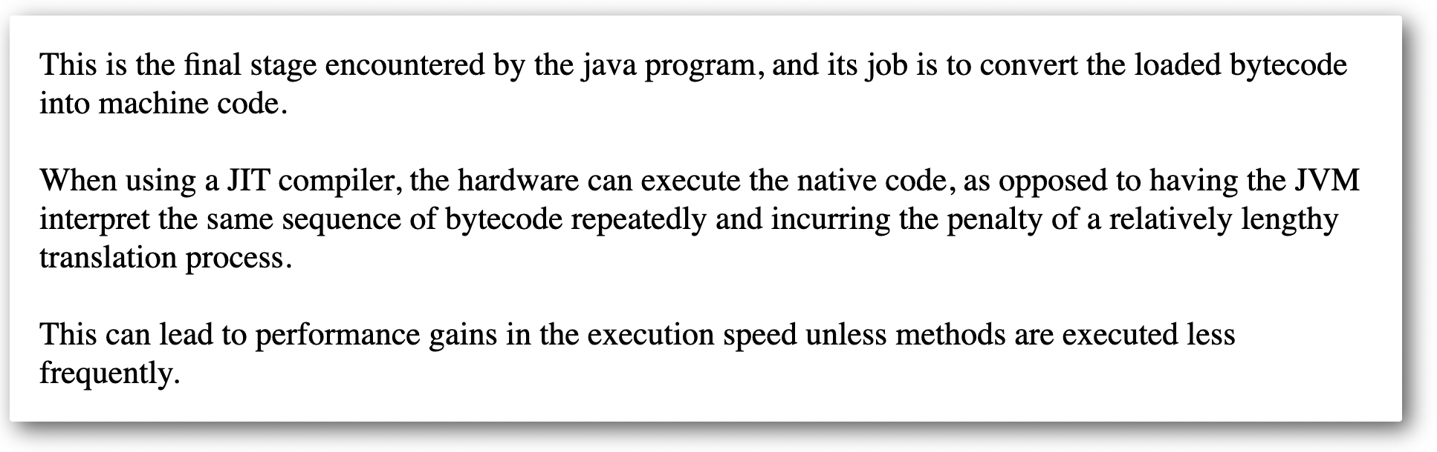
Java: JIT(Just in time Compiler)

Slide 30
Java: JIT(Just in time Compiler)

Slide 31
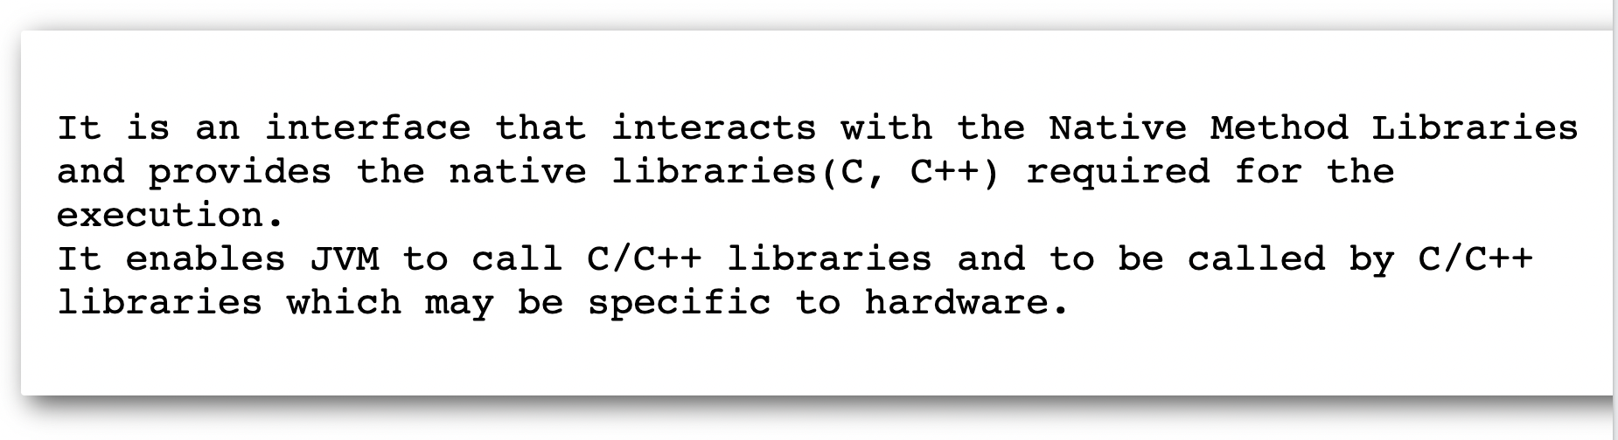
JVM:Java Native Interface

Slide 32
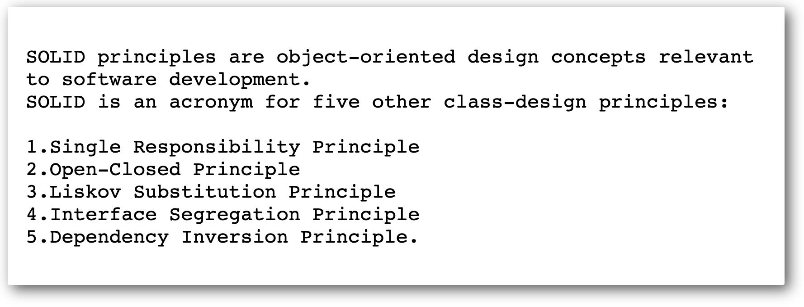
SOLID Principle in Java

Slide 33
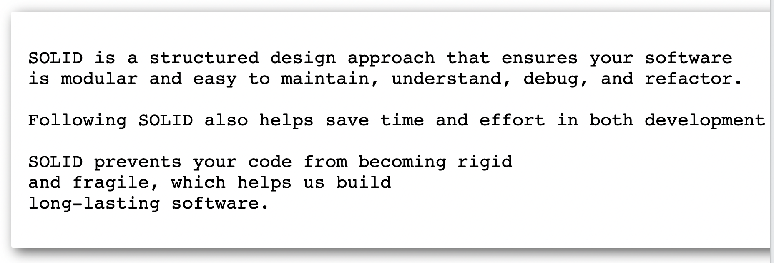
SOLID Principle in Java

Slide 34
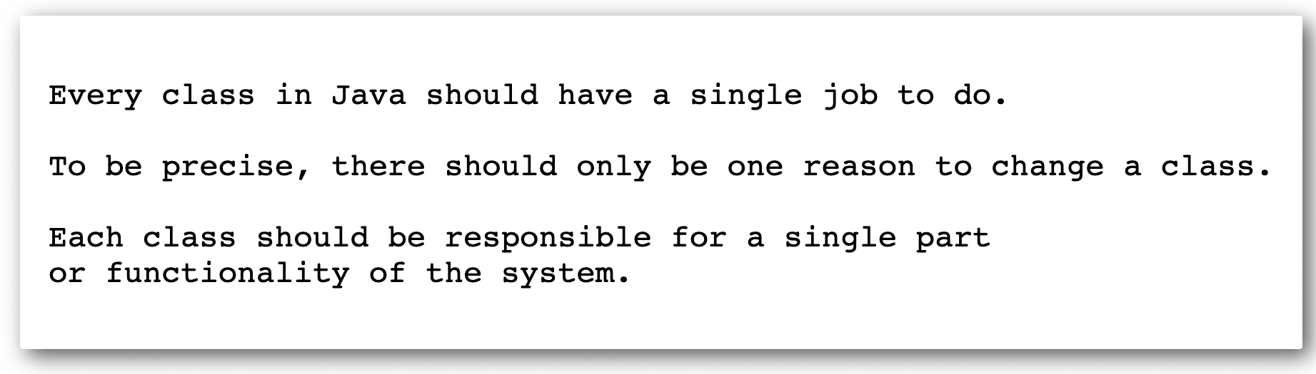
SOLID (Single Responsibility Principle)

Slide 35
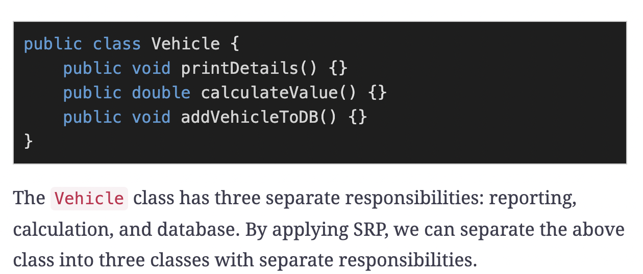
SOLID (Single Responsibility Principle)

Slide 36
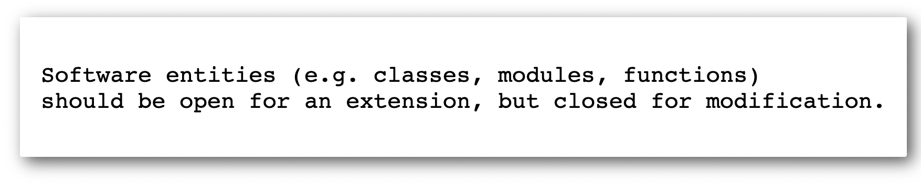
SOLID (Open Closed Principle)

Slide 37
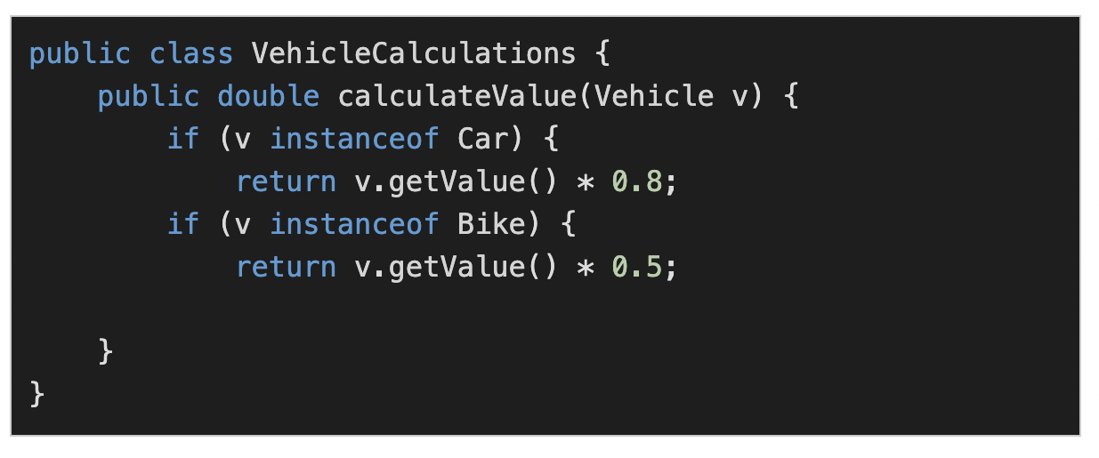
SOLID (Open Closed Principle)

Slide 38
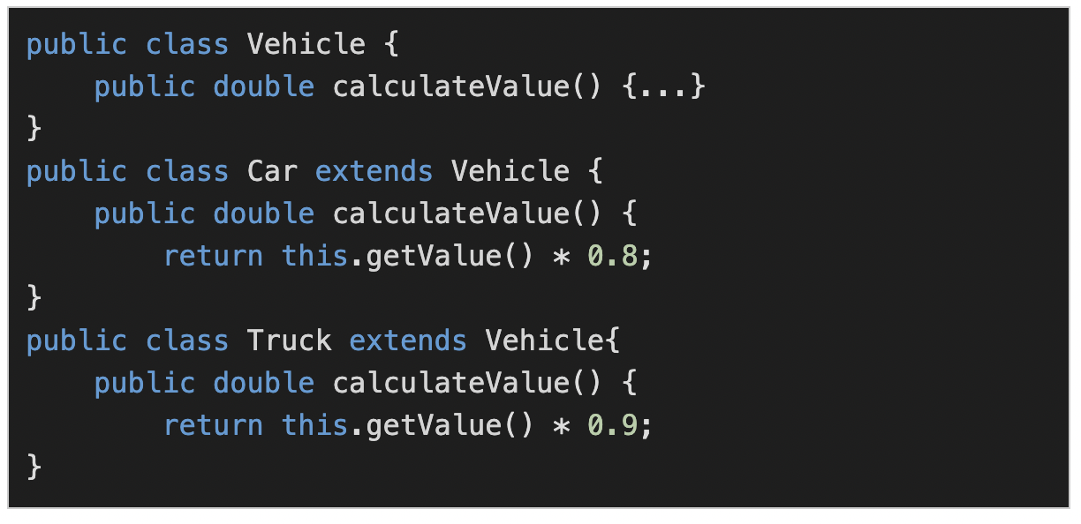
SOLID (Open Closed Principle)

Slide 39
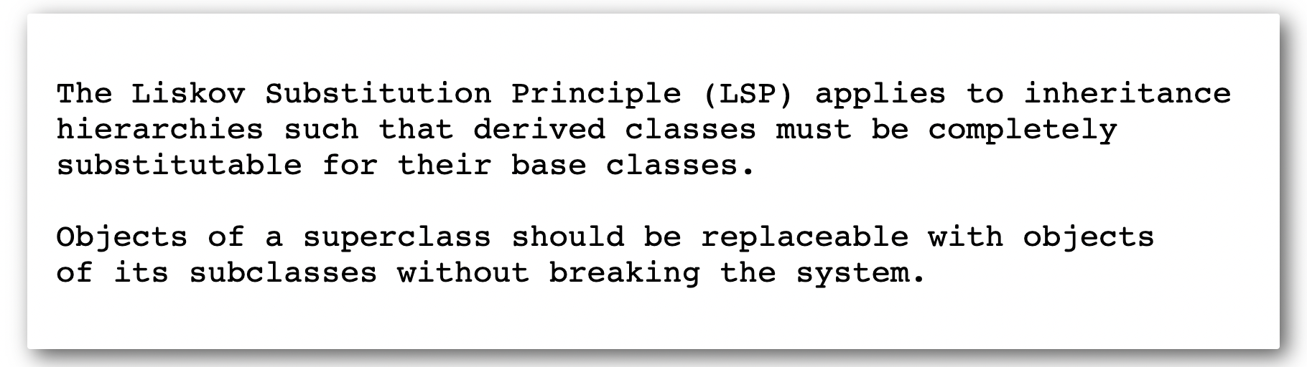
SOLID (Liskov Substitution Principle)

Slide 40
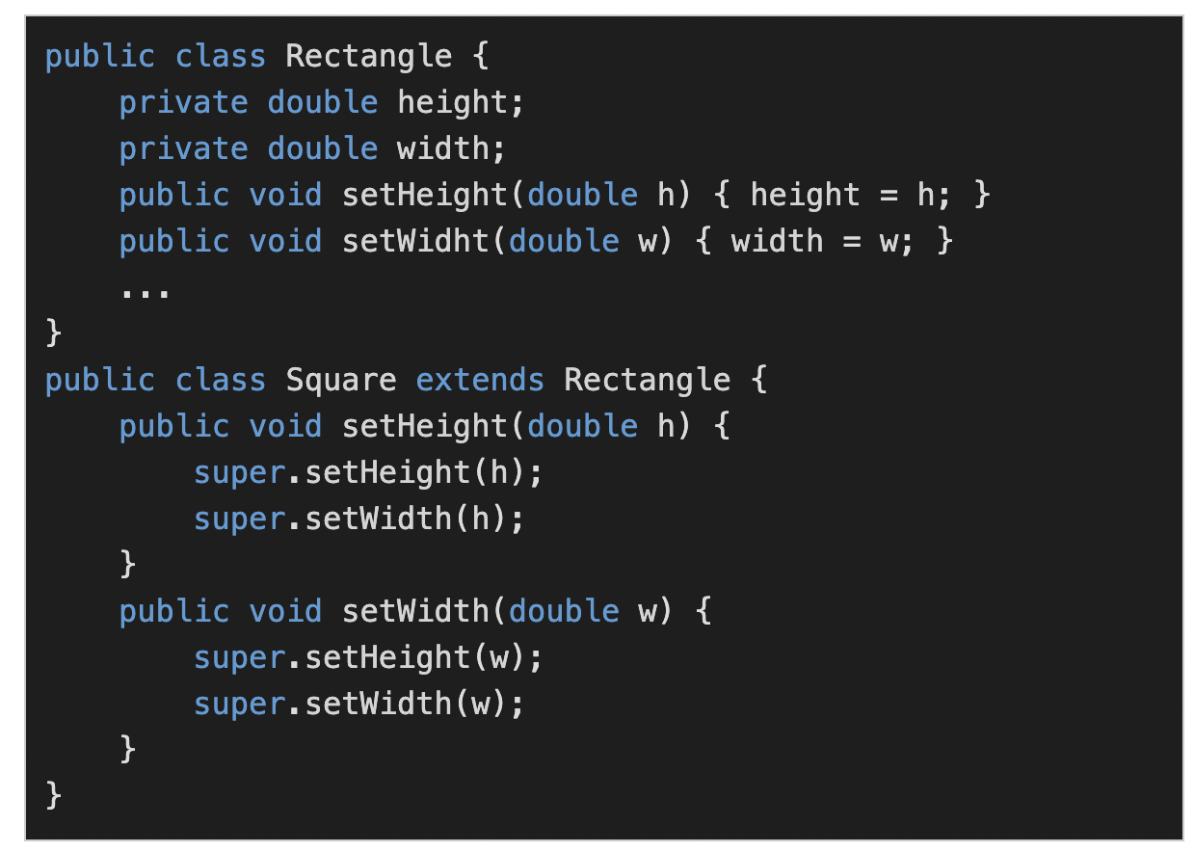
SOLID (Liskov Substitution Principle)

Slide 41
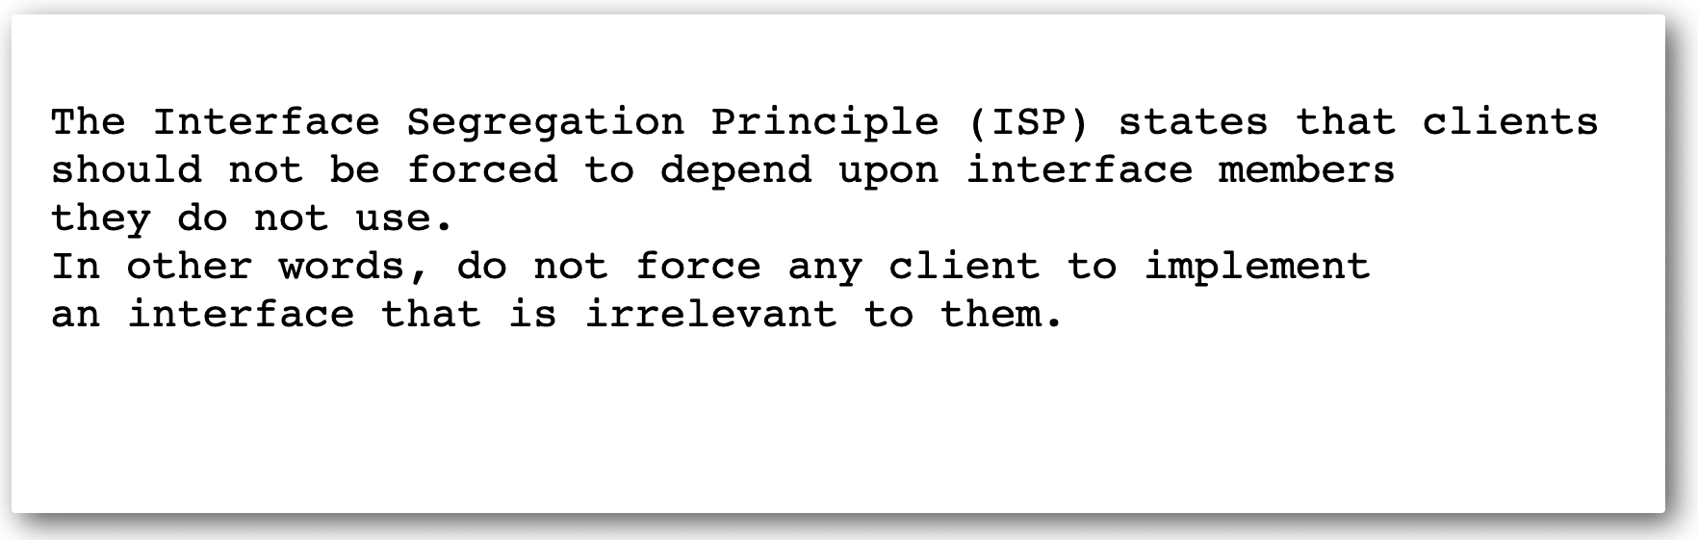
SOLID (Interface Segregation Principle)

Slide 42
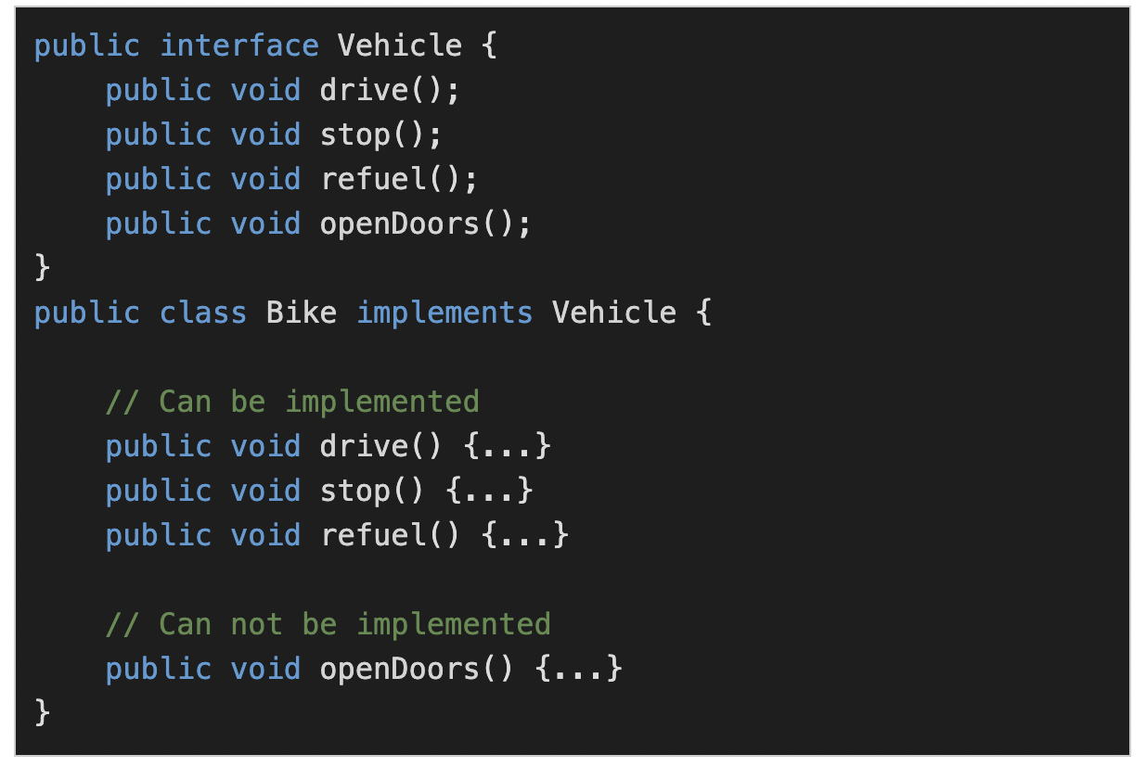
SOLID (Interface Segregation Principle)

Slide 43
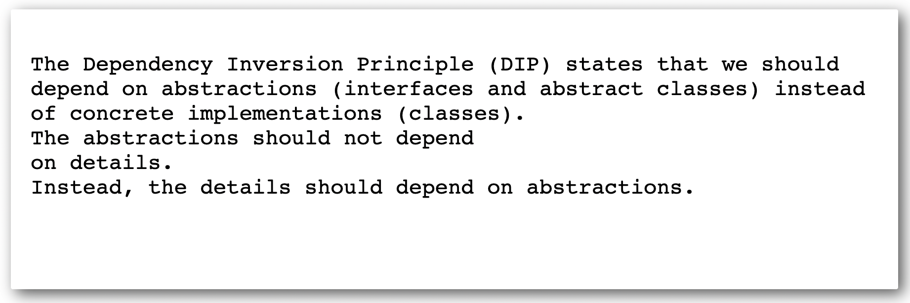
SOLID (Dependency Inversion Principle)

Slide 44
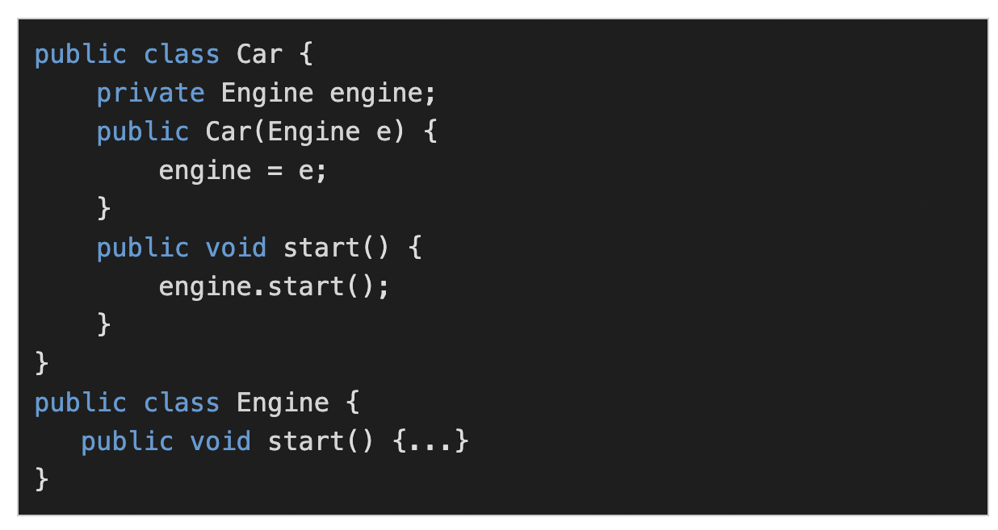
SOLID (Dependency Inversion Principle)

Slide 45
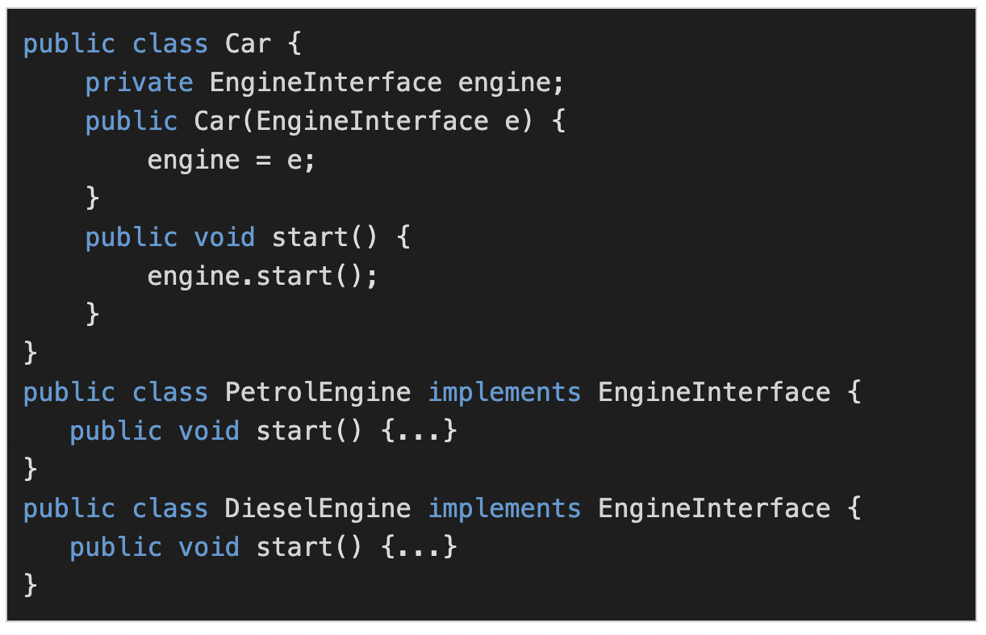
SOLID (Dependency Inversion Principle)

